Slide 1
Chapter 07_04
Greedy Algorithms:
Scheduling and
Huffman Trees and Codes

Slide 2
Scheduling with minimizing total time in the system
Consider a problem of optimally scheduling multiple jobs (customers) to be served by a processor (producer), where jobs do not all take the same amount of time to be completely served, but the producer knows how long each takes.
An optimal schedule would be minimizing the total time customers spent both waiting and being served (executed).
The time spent both waiting and being served is called the time in the system.
The problem of minimizing the total time in the system has many applications. For example,
schedule users’ access to a disk drive to minimize the total time they spend waiting and being served.

Slide 3
Scheduling with deadlines
Another scheduling problem is when each job (customer) takes the same amount of time to complete but has a deadline by which it must start to yield a profit associated with the job.
The goal is to schedule the jobs to maximize the total profit.

Slide 4
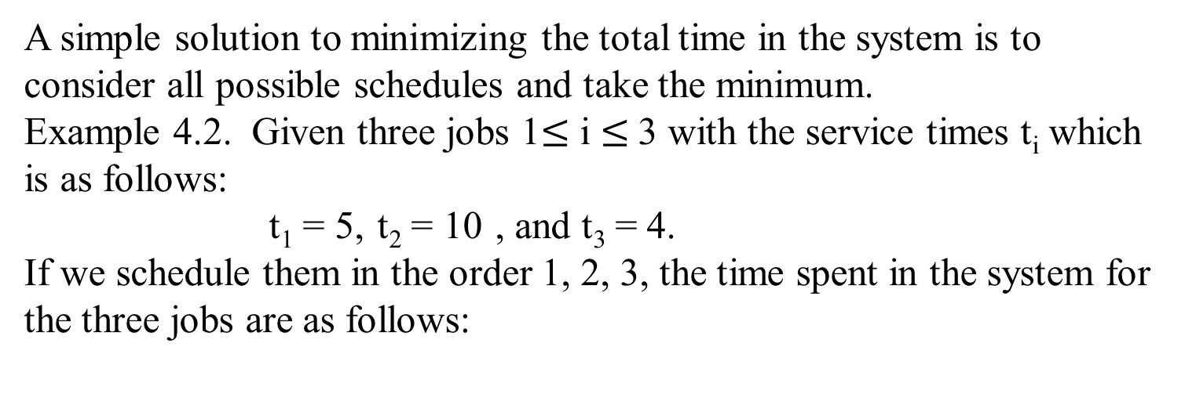
Scheduling with minimizing total time in the system
A simple solution to minimizing the total time in the system is to consider all possible schedules and take the minimum.
Example 4.2. Given three jobs 1$≤$ i $≤$3 with the service times t_{i} which is as follows:
t₁ = 5, t₂ = 10 , and t₃ = 4.
If we schedule them in the order 1, 2, 3, the time spent in the system for the three jobs are as follows:
Job | Time in the System | Total time in the System for this Schedule is 39
1 | 5 (service time) | Time for job 1 = 5
2 | 5 (wait for job 1) + 10 (service time) | + Time for job 2 = 15
3 | 5 (wait for job 1) + 10 (wait for job 2) + 4 (service time) | + Time for job 3 = 19

Slide 5
Scheduling with minimizing total time in the system
The total times in the system for each of the all possible schedules are:
Schedule [3, 1, 2] is optimal with a total of 32.
Schedule | Total Time in the System
1, 2, 3 | 5 + (5 + 10) + (5 + 10 + 4) = 39
1, 3, 2 | 5 + (5 + 4) + (5 + 4 + 10) = 33
2, 1, 3 | 10 + (10 + 5) + (10 + 5 + 4) = 44
2, 3, 1 | 10 + (10 + 4) + (10 + 4 + 5) = 43
3, 1, 2 | 4 + (4 + 5) + (4 + 5 + 10) = 32
3, 2, 1 | 4 + (4 + 10) + (4 + 10 + 5) = 37

Slide 6
Scheduling with minimizing total time in the system
A general form of a greedy algorithm for finding the scheduling with minimizing total time in the system:
sort the jobs by service time in nondecreasing order;
while (the instance is not solved) {
schedule the next job; //selection procedure and
//feasibility check
if (there are no more jobs) //solution check
the instance is solved
}

Slide 7
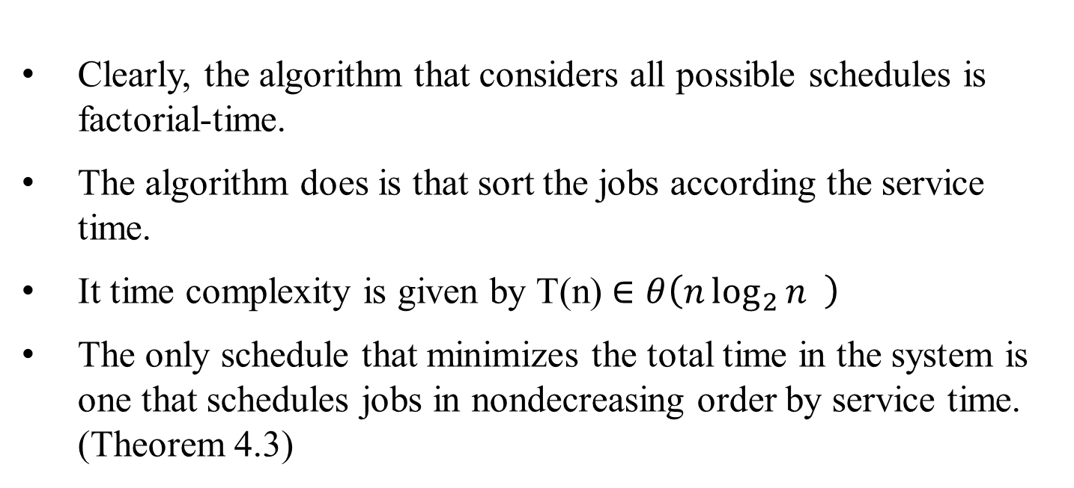
Scheduling with minimizing total time in the system
Clearly, the algorithm that considers all possible schedules is factorial-time.
The algorithm does is that sort the jobs according the service time.
It time complexity is given by T(n) $∈θ\left(n\log_{2}{n} \right)$
The only schedule that minimizes the total time in the system is one that schedules jobs in nondecreasing order by service time. (Theorem 4.3)

Slide 8
Scheduling with Deadlines
For this scheduling problem, each job takes one unit of time to finish and has a deadline and a profit.
If the job starts before or at its deadline, the profit is obtained.
The goal is to schedule the jobs so as to maximize the total profit.
Not all the jobs have to be scheduled.
We need not consider any schedule that has a job scheduled after its deadline because that schedule has the same profit as one that doesn’t schedule the job at all. We call such a schedule impossible.

Slide 9
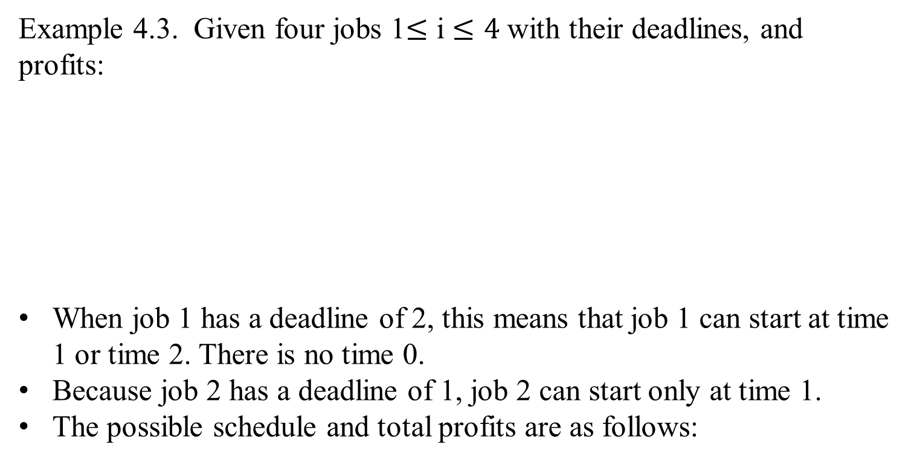
Scheduling with Deadlines
Example 4.3. Given four jobs 1$≤$ i $≤4$ with their deadlines, and profits:
When job 1 has a deadline of 2, this means that job 1 can start at time 1 or time 2. There is no time 0.
Because job 2 has a deadline of 1, job 2 can start only at time 1.
The possible schedule and total profits are as follows:
Job | Deadlines | Profits
1 | 2 | 30
2 | 1 | 35
3 | 2 | 25
4 | 1 | 40

Slide 10
Scheduling with Deadlines
The possible schedule and total profits are as follows:
Impossible schedules are [1, 2], [1, 4], [3, 2], [3, 4], [2, 4], [4, 2] schedules. Schedule [1, 2] is not possible, because job 1 would start at time 1 and take one unit of time to finish, causing job 2 to start at time 2.
However, the deadline for job 2 is time 1. Schedule [1, 3] is possible because job 1 is started before its deadline, and job 3 is started at its deadline.
Schedule [4, 1] is optimal with a total profit of 70.
Job | Deadlines | Profits
1 | 2 | 30
2 | 1 | 35
3 | 2 | 25
4 | 1 | 40
Schedule | Total Profits
[1, 3] | 30+25=55
[2, 1] | 35+30=65
[2, 3] | 35+25=60
[3, 1] | 25+30=55
[4, 1] | 40+30=70
[4, 3] | 40+25=65
[1, 2], [1, 4], [3, 2], [3, 4], [2, 4], [4, 2] | impossible

Slide 11
Scheduling with Deadlines
Job | Deadlines | Profits
1 | 2 | 30
2 | 1 | 35
3 | 2 | 25
4 | 1 | 40
To consider all schedule in Example 4.3 takes factorial time.
For the optimal schedule [4, 1], notice that
the job 4 which has the greatest profit is included in the optimal schedule, but
the job 2 with the second-greatest profit is not. Because both jobs have deadlines equal to 1, both cannot be scheduled.
Then the job 1 is scheduled, because its profit is greater than that of job 3.
This suggests that a reasonable greedy approach to solving the problem would be to first sort the jobs in nonincreasing order by profit, and next inspect each job in sequence and add it to the schedule if it is possible.

Slide 12
Scheduling with Deadlines
A sequence is called a feasible sequence if all the jobs in the sequence start by their deadline.
For example, in Example 4.3, [4, 1] is a feasible sequence, but [1, 4] is not a feasible sequence.
A set of jobs is called a feasible set if there exists at least one feasible sequence for the jobs in the set.
In Example 4.3, {1, 4} is a feasible set because the scheduling sequence [4, 1] is feasible, where {2, 4} is not a feasible set because no scheduling sequence allows both jobs to start by their deadlines.
An optimal sequence is a feasible sequence with maximum total profit; and the set of jobs in the sequence is an optimal set of jobs.
Our goal is to find a feasible sequence with maximum total profit.

Slide 13
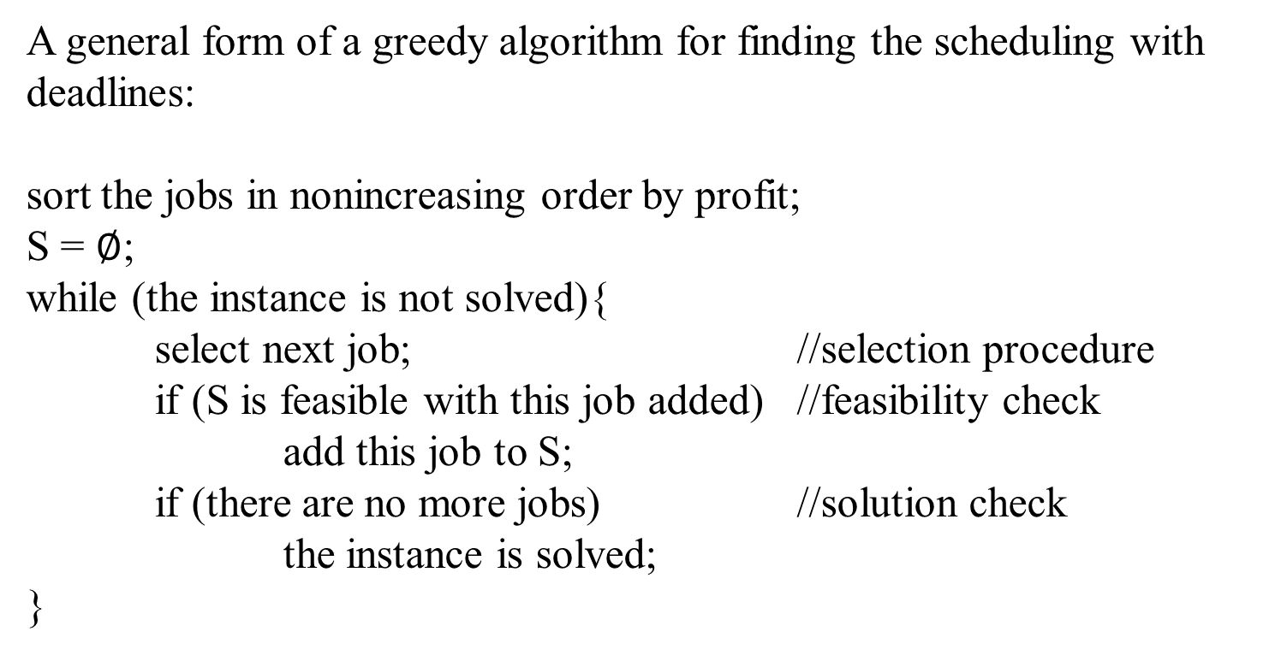
Scheduling with Deadlines
A general form of a greedy algorithm for finding the scheduling with deadlines:
sort the jobs in nonincreasing order by profit;
S = $∅$;
while (the instance is not solved){
select next job; //selection procedure
if (S is feasible with this job added) //feasibility check
add this job to S;
if (there are no more jobs) //solution check
the instance is solved;
}

Slide 14
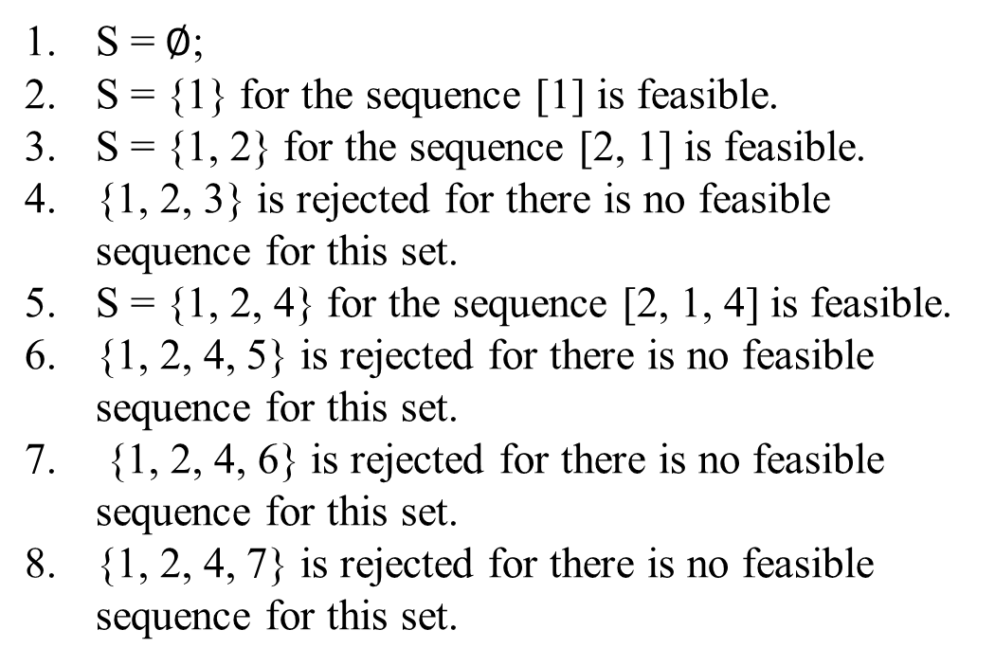
Scheduling with Deadlines
Example 4.4. An example illustrates this algorithm for the scheduling with deadlines. Given the following jobs, deadlines, and profits, the jobs are sorted before labeling them. Then apply the greedy algorithm to obtain the following:
S = $∅$;
S = {1} for the sequence [1] is feasible.
S = {1, 2} for the sequence [2, 1] is feasible.
{1, 2, 3} is rejected for there is no feasible sequence for this set.
S = {1, 2, 4} for the sequence [2, 1, 4] is feasible.
{1, 2, 4, 5} is rejected for there is no feasible sequence for this set.
{1, 2, 4, 6} is rejected for there is no feasible sequence for this set.
{1, 2, 4, 7} is rejected for there is no feasible sequence for this set.
Job | Deadlines | Profits
1 | 3 | 40
2 | 1 | 35
3 | 1 | 30
4 | 3 | 25
5 | 1 | 20
6 | 3 | 15
7 | 2 | 10

Slide 15
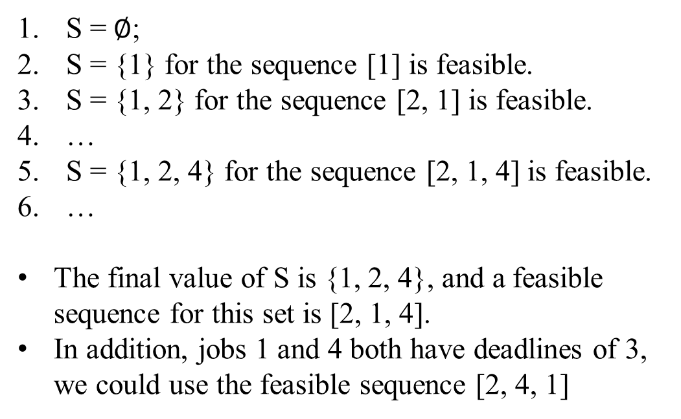
Scheduling with Deadlines
Example 4.4. An example illustrates this algorithm for the scheduling with deadlines. Given the following jobs, deadlines, and profits, the jobs are sorted before labeling them. Then apply the greedy algorithm to obtain the following:
S = $∅$;
S = {1} for the sequence [1] is feasible.
S = {1, 2} for the sequence [2, 1] is feasible.
…
S = {1, 2, 4} for the sequence [2, 1, 4] is feasible.
…
The final value of S is {1, 2, 4}, and a feasible sequence for this set is [2, 1, 4].
In addition, jobs 1 and 4 both have deadlines of 3, we could use the feasible sequence [2, 4, 1]
Job | Deadlines | Profits
1 | 3 | 40
2 | 1 | 35
3 | 1 | 30
4 | 3 | 25
5 | 1 | 20
6 | 3 | 15
7 | 2 | 10

Slide 16
Scheduling with Deadlines
To refine this algorithm requires an efficient way to determine whether a set is feasible. To consider all possible sequences is not acceptable because it would take factorial time to do this.
The following lemma enables us to check efficiently whether or not a set is feasible.
Lemma 4.3. Let S be a set of jobs. Then S is feasible if and only if the sequence obtained by ordering the jobs in S according to nondecreasing deadlines is feasible.
Proof: Leave it to readers.

Slide 17
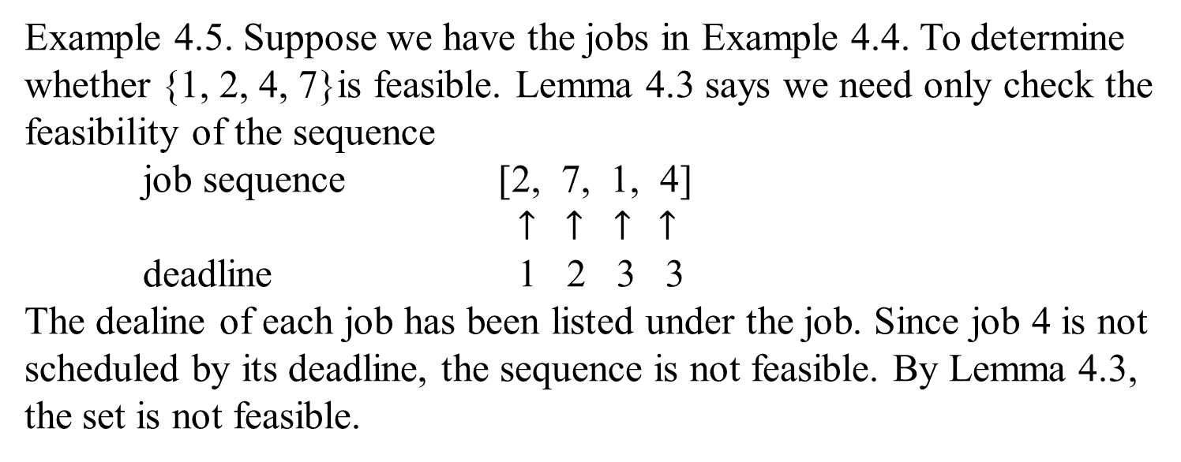
Scheduling with Deadlines
Example 4.5. Suppose we have the jobs in Example 4.4. To determine whether {1, 2, 4, 7}is feasible. Lemma 4.3 says we need only check the feasibility of the sequence
job sequence [2, 7, 1, 4]
$↑$ $↑$ $↑$ $↑$
deadline 1 2 3 3
The dealine of each job has been listed under the job. Since job 4 is not scheduled by its deadline, the sequence is not feasible. By Lemma 4.3, the set is not feasible.

Slide 18
Scheduling with Deadlines
Algorithm 4.4 for determining the schedule with deadline
Problem: Determine the schedule with maximum total profit given that
each job has a profit that will be obtained only if the job is
scheduled by its deadline.
Input: The number of jobs, and array of integers deadline, indexed
from 1 to n, where deadline[i] is the deadline for the i^{th} job.
The array has been sorted in nonincreasing order according to
the profits associated with the jobs. (Assume that the jobs
have already been sorted by profit in nonincreasing order,
before being passed to the algorithm.)
Output: An optimal sequence J for the jobs.

Slide 19
Scheduling with Deadlines
void schedule (int n, const int deadline[ ], sequence_of_integer& J)
{
index i;
sequence_of_integer K;
J = [1];
for (i = 2; i <= n; i++){
K = J with i added according to nondecreasing values
of deadline[i];
if (K is feasible)
J = K;
}
}

Slide 20
Scheduling with Deadlines
Example 4.6. Given the jobs with deadlines and profits in Example 4.4.
Job | Deadlines | Profits
1 | 3 | 40
2 | 1 | 35
3 | 1 | 30
4 | 3 | 25
5 | 1 | 20
6 | 3 | 15
7 | 2 | 10
J = [1].
K = [2, 1] and is determined to be feasible.
J = [2, 1] for K is feasible.
K = [2, 3, 1] and is rejected for it is not feasible.
K = [2, 1, 4] and is determined to be feasible.
J = [2, 1, 4] for K is feasible.
K = [2, 5, 1, 4] and is rejected for it is not feasible.
K = [2, 1, 6, 4] and is rejected for it is not feasible.
K = [2, 7, 1, 4] and is rejected for it is not feasible.
The final value of J is [2, 1, 4].

Slide 21
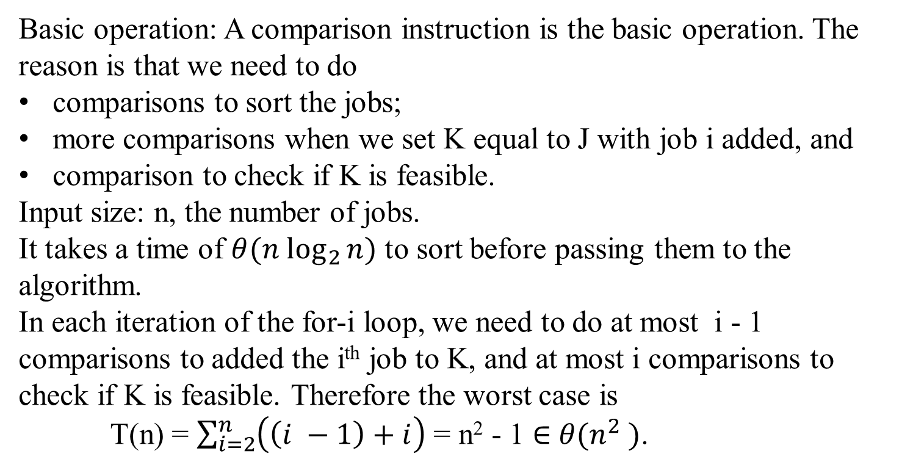
Time Complexity for Scheduling with Deadlines
Basic operation: A comparison instruction is the basic operation. The reason is that we need to do
comparisons to sort the jobs;
more comparisons when we set K equal to J with job i added, and
comparison to check if K is feasible.
Input size: n, the number of jobs.
It takes a time of $θ({n log}_{2}{n)}$ to sort before passing them to the algorithm.
In each iteration of the for-i loop, we need to do at most i - 1 comparisons to added the i^{th} job to K, and at most i comparisons to check if K is feasible. Therefore the worst case is
T(n) = $\sum_{i=2}^{n}{\left(\left(i −1\right)+i\right)}$ = n² - 1 $∈$ $θ(n^{2} )$.

Slide 22
Scheduling with Deadlines
Theorem 4.4. Algorithm 4.4 always produces an optimal set of jobs.
Proof: Leave for the reader (175-176)

Slide 23
Hoffman Trees and Codes

Slide 24

Huffman Trees and Codes
Find a way to store a given data file efficiently.
The problem of data compression is to find an efficient method for encoding a data file.
An encoding method is Huffman code
A greedy algorithm for finding a Huffman encoding for a given file.
Using a binary code is a common way to represent a file.
Each character is represented by a unique binary string, called the code word.

Slide 25

Huffman Trees and Codes
Let encode a text into a sequence of bits:
The given text comprises characters from some n-character alphabet
assigns to each of the text’s characters some sequence of bits called the codeword.
For example:
character | A | B | C | D | -
frequency | 0.35 | 0.1 | 0.2 | 0.2 | 0.15
codeword | 11 | 100 | 00 | 01 | 101

Slide 26

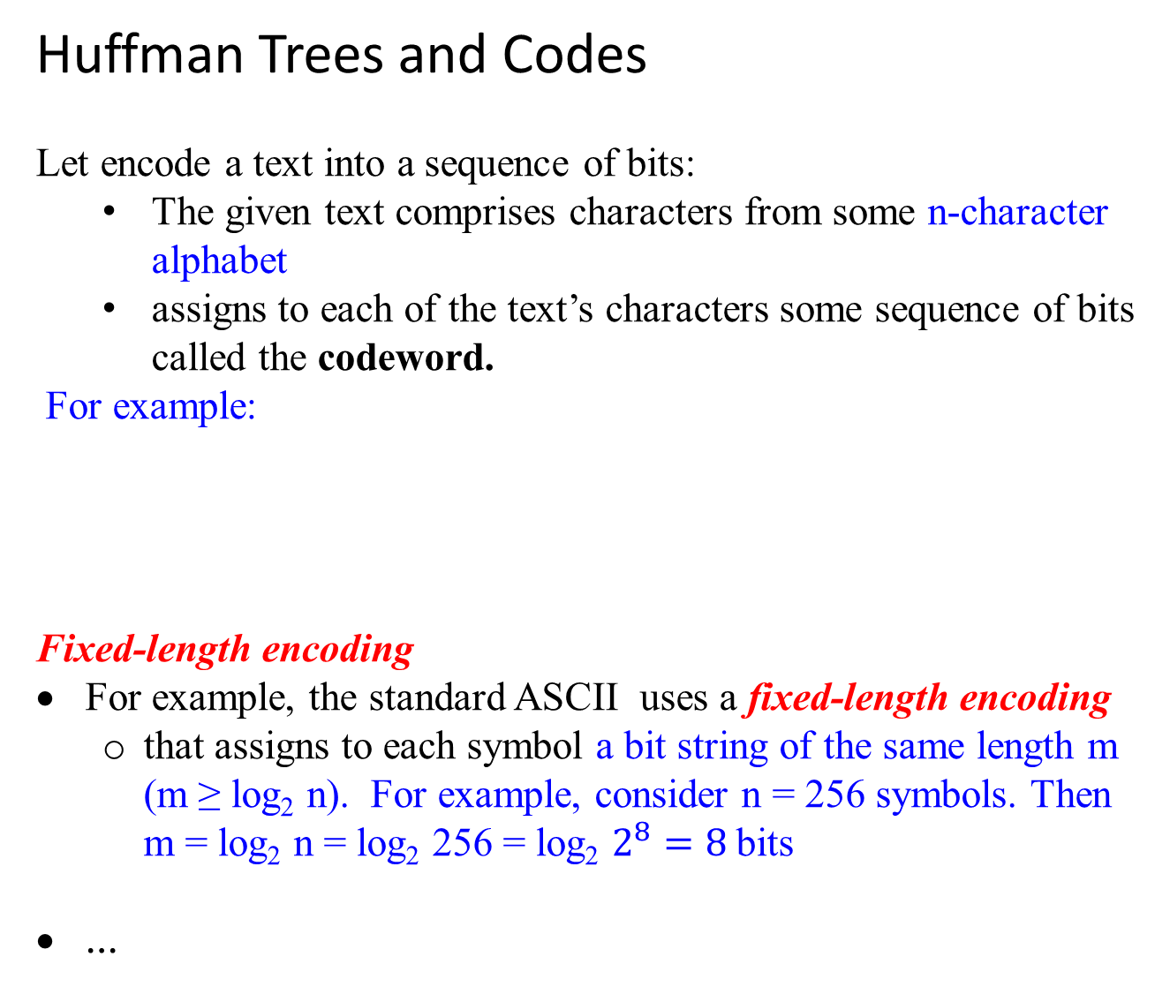
Huffman Trees and Codes
Let encode a text into a sequence of bits:
The given text comprises characters from some n-character alphabet
assigns to each of the text’s characters some sequence of bits called the codeword.
For example:
Fixed-length encoding
For example, the standard ASCII uses a fixed-length encoding
that assigns to each symbol a bit string of the same length m (m ≥ log₂ n). For example, consider n = 256 symbols. Then m = log₂ n = log₂ 256 = log₂ $2^{8}=8$bits
…
symbol | A | B | C | D | -
frequency | 0.35 | 0.1 | 0.2 | 0.2 | 0.15
codeword | 11 | 100 | 00 | 01 | 101

Slide 27
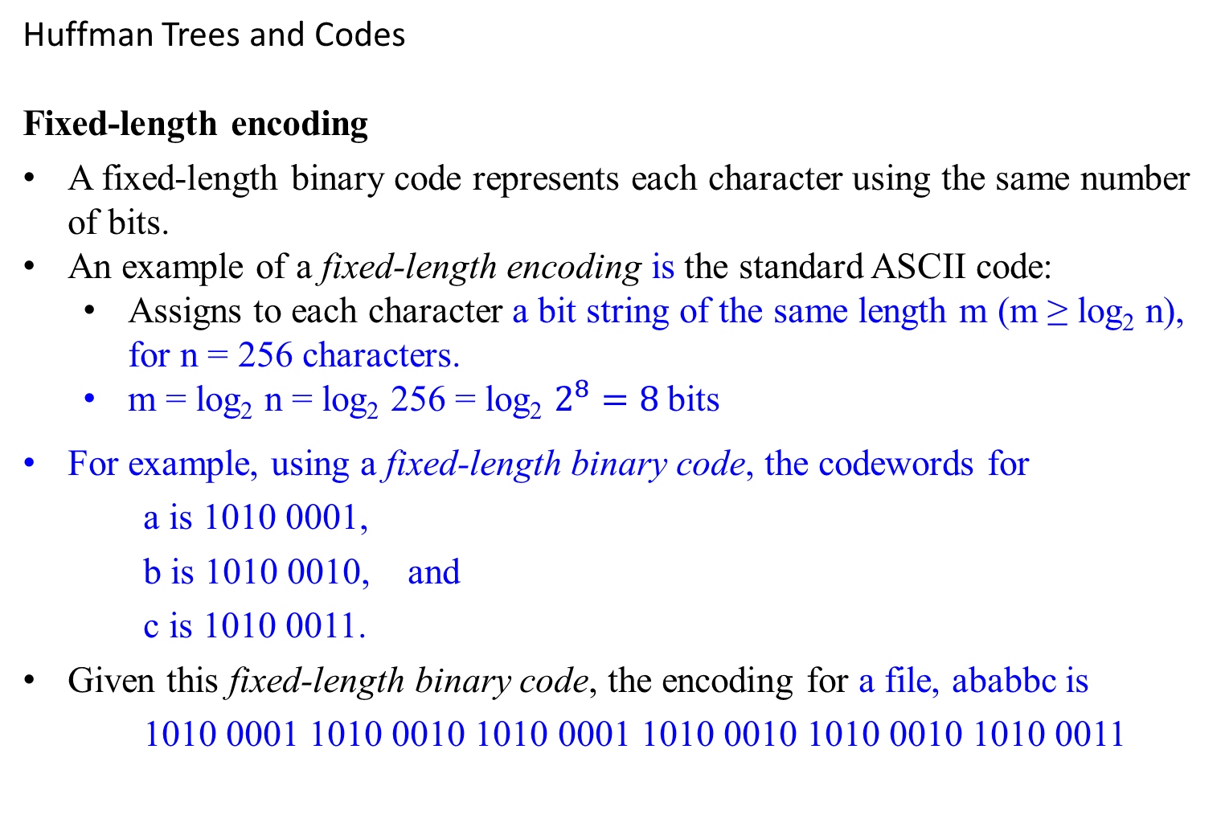
Huffman Trees and Codes
Fixed-length encoding
A fixed-length binary code represents each character using the same number of bits.
An example of a fixed-length encoding is the standard ASCII code:
Assigns to each character a bit string of the same length m (m ≥ log₂ n), for n = 256 characters.
m = log₂ n = log₂ 256 = log₂ $2^{8}=8$bits
For example, using a fixed-length binary code, the codewords for
a is 1010 0001,
b is 1010 0010, and
c is 1010 0011.
Given this fixed-length binary code, the encoding for a file, ababbc is
1010 0001 1010 0010 1010 0001 1010 0010 1010 0010 1010 0011

Slide 28

Huffman Trees and Codes
Is Fixed-length encoding optimal?
The minimum number of bits necessary to represent the file with a binary character code.
Designing a coding scheme that yields a shorter bit string on the average is based on the idea of assigning
shorter codewords to more frequent characters and
longer codewords to less frequent characters.
This idea was used in the telegraph code
invented in the mid-19th century by Samuel Morse.
assigned short sequences of dots and dashes for frequent letters such as e ( . ) and a ( .- )
while infrequency letters such as q ( --.- ) and z( --.. ) have longer ones.

Slide 29

Variable-length encoding
Variable-length encoding assigns codewords of different lengths to different characters. This code is called variable-length binary code.
In previous example, suppose the character set is {a, b, c}. A possible codewords are:
a is 10, b is 0 and c is 11
Then, the encoding of a text file, ababbc is 10 0 10 0 0 11
Given a file, this encoding is optimal using the minimum number of bits necessary to represent the file with a binary character code.
Introduces a problem that fixed-length encoding does not have.
Given a file, the Optimal Binary Code problem is to find a binary character code for the characters in the file, which represents the file in the least number of bits.
The problem is how can we tell how many bits of an encoded text represent the first (or, more generally, the i^{th} ) character?

Slide 30
Variable-length encoding
Prefix codes (also called prefix-free codes)
In a prefix code, no codeword of one character is a prefix of a codeword of another character.
An example: if 01 is the codeword for ‘a’, then 011 could not be the codeword for ‘b’.
The following code is an example of a prefix code:
a is 10, b is 0 and c is 11
Every prefix code can be represented by a binary tree whose leaves are the characters that are to be encoded.
0
1
b
0
1
a
c

Slide 31
Variable-length encoding
Prefix codes (also called prefix-free codes)
A prefix code, is that there needs not look ahead when parsing the file. This readily apparent from the tree representation of the code.
To parse, start at the first bits on the left in the file and the root of the tree.
Sequence through the bits, and go left or right down the tree depending on whether a 0 or 1 is encountered.
When a leaf is reached, a character is obtained at that leaf; and then return to the root and repeat the procedure starting with the next bit in sequence.
Hence, with such an encoding, we can simply
scan a bit string until we get the first group of bits that is a codeword for some character,
replace these bits by this character, and
repeat this operation until the bit string’s end is reached.

Slide 32
Variable-length encoding
Binary prefix code
For creating a binary prefix code for some alphabet, associate the alphabet’s characters with leaves of a binary tree in which
all the left edges are labeled by 0 and
all the right edges are labeled by 1. (Or vice versa).
The codeword of a character can then be obtained by recording the labels on the simple path from the root to the character’s leaf.
Since there is no simple path to a leaf that continues to another leaf, no codeword can be a prefix of another codeword;
hence, any such tree yields a prefix code.

Slide 33
Variable-length encoding
Binary prefix code
For a given alphabet with known frequencies of the character occurrences, many trees can be constructed in this manner.
How can we construct a tree that would assign
shorter bit strings to high-frequency characters and
longer ones to low-frequency characters?
It can be done by the following greedy algorithm, invented by David Huffman while he was a graduate student at MIT [Huf52].

Slide 34
Huffman’s algorithm
Step 1
Initialize n one-node trees and label them with the characters of the alphabet given.
(More generally, the weight of a tree will be equal to the sum of the frequencies in the tree’s leaves.)
Step 2
Repeat the following operation until a single tree is obtained.
Find two trees with the smallest weight (tie can be broken arbitrarily).
Make them the left and right subtree of a new tree and record the sum of their weights in the root of the new tree as its weight.
A tree constructed by the above algorithm is called a Huffman tree. It defines a Huffman code.

Slide 35
Huffman’s algorithm
Example: Consider the five-character alphabet {A, B, C, D, … } with the following occurrence frequencies in a text made up of these symbols:
character A B C D -
frequency 0.35 0.1 0.2 0.2 0.15
0.1
B
0.15
-
0.2
C
0.2
D
0.35
A
0.25
0.2
C
0.2
D
0.35
A
0.1
B
0.15
-

Slide 36

0.25
0.2
C
0.2
D
0.35
A
0.1
B
0.15
-
0.25
0.35
A
0.4
0.1
B
0.15
-
0.2
C
0.2
D

Slide 37
0.25
0.35
A
0.4
0.1
B
0.15
-
0.2
C
0.2
D
0.4
0.6
0.2
C
0.2
D
0.25
0.35
A
0.1
B
0.15
-

Slide 38
1.0
0.4
0.6
1
0
0.4
0.6
0.2
C
0.2
D
0.25
0.35
A
0
1
1
0
0.2
C
0.2
D
0.25
0.35
A
0.1
B
0.15
-
0
1
0.1
B
0.15
-
Figure 9.12 Example of constructing a Huffman coding tree.

Slide 39
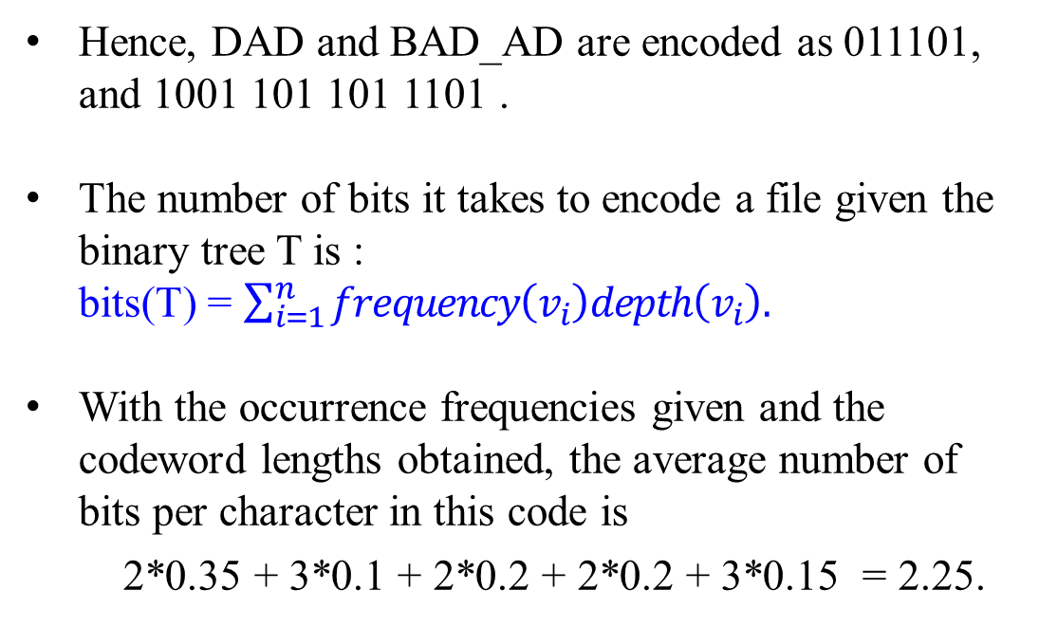
The resulting (Huffman’s code) codewords are as follows:
character | A | B | C | D | -
frequency | 0.35 | 0.1 | 0.2 | 0.2 | 0.15
codeword | 11 | 100 | 00 | 01 | 101
Huffman’s Tree and Code
Hence, DAD and BAD_AD are encoded as 011101, and 1001 101 101 1101 .
The number of bits it takes to encode a file given the binary tree T is : bits(T) = $\sum_{i=1}^{n}{frequency\left(v_{i}\right)depth\left(v_{i}\right).}$
With the occurrence frequencies given and the codeword lengths obtained, the average number of bits per character in this code is
2*0.35 + 3*0.1 + 2*0.2 + 2*0.2 + 3*0.15 = 2.25.
1.0
0
1
0.4
0.6
0
1
0
1
0.2
C
0.2
D
0.25
0.35
A
0
1
0.1
B
0.15
-

Slide 40
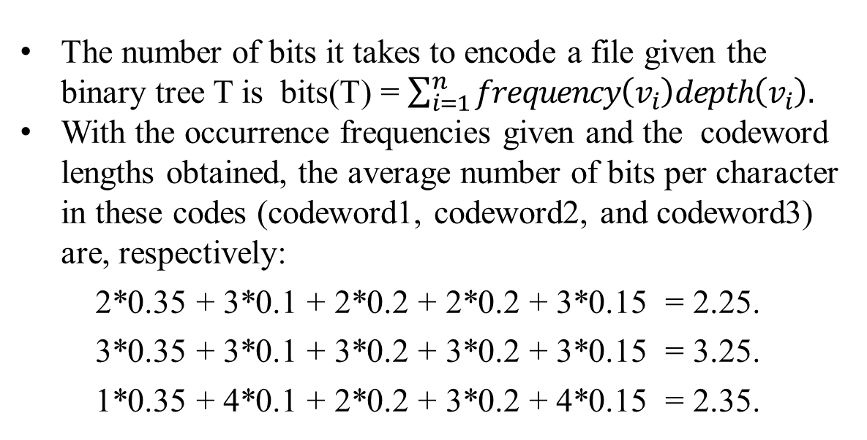
Table: codeword1 is Huffman’s , codeword2 is fixed-
length code, and codeword3 is prefix-free code.
Prefix-free Code
character | A | B | C | D | -
frequency | 0.35 | 0.1 | 0.2 | 0.2 | 0.15
codeword1 | 11 | 100 | 00 | 01 | 101
codeword2 | 000 | 001 | 010 | 011 | 100
codeword3 | 0 | 1111 | 10 | 110 | 1110
0
1
0.35
A
0
The number of bits it takes to encode a file given the binary tree T is bits(T) = $\sum_{i=1}^{n}{frequency\left(v_{i}\right)depth\left(v_{i}\right).}$
With the occurrence frequencies given and the codeword lengths obtained, the average number of bits per character in these codes (codeword1, codeword2, and codeword3) are, respectively:
2*0.35 + 3*0.1 + 2*0.2 + 2*0.2 + 3*0.15 = 2.25.
3*0.35 + 3*0.1 + 3*0.2 + 3*0.2 + 3*0.15 = 3.25.
1*0.35 + 4*0.1 + 2*0.2 + 3*0.2 + 4*0.15 = 2.35.
1
0.2
C
0
1
0.2
D
0
1
0.15
-
0.1
B

Slide 41
If a fixed-length encoding is used for the same alphabet, then at least 3 bits per each character is needed.
Consider that the compression ratio is a standard measure of a compression algorithm’s effectiveness.
For this example, Huffman’s code achieves the compression ratio of
(3 – 2.25)/3 *100% = 25%.
Huffman’s encoding of the text will use 25% less memory than its fixed-length encoding.
Extensive experiments with Huffman codes shows that
the compression ratio for this scheme typically falls between 20% and 80%, depending on the characteristics of the text being compressed.

Slide 42
Huffman’s encoding is one of the most important file-compression methods.
Its simplicity and versatility,
It yields an optimal (i.e., minimal-length) encoding
provided the frequencies of character occurrences are independent and known in advance.
The simplest version of Huffman compression
calls for a preliminary scanning of a given text to count the frequencies of character occurrences in it.
Then uses these frequencies to construct a Huffman coding tree and encode the text as described above.
This scheme makes it necessary to include the coding table into the encoded text to make its decoding possible.
…

Slide 43
Huffman’s encoding is one of the most important file-compression methods.
…
This drawback can be overcome by using dynamic Huffman encoding, in which
the coding tree is updated each time a new character is read from the source text.
Modern alternatives such as Lempel-Ziv algorithms assign codewords not to individual characters but to strings of characters allowing them to achieve better and more robust compressions in many applications.

Slide 44
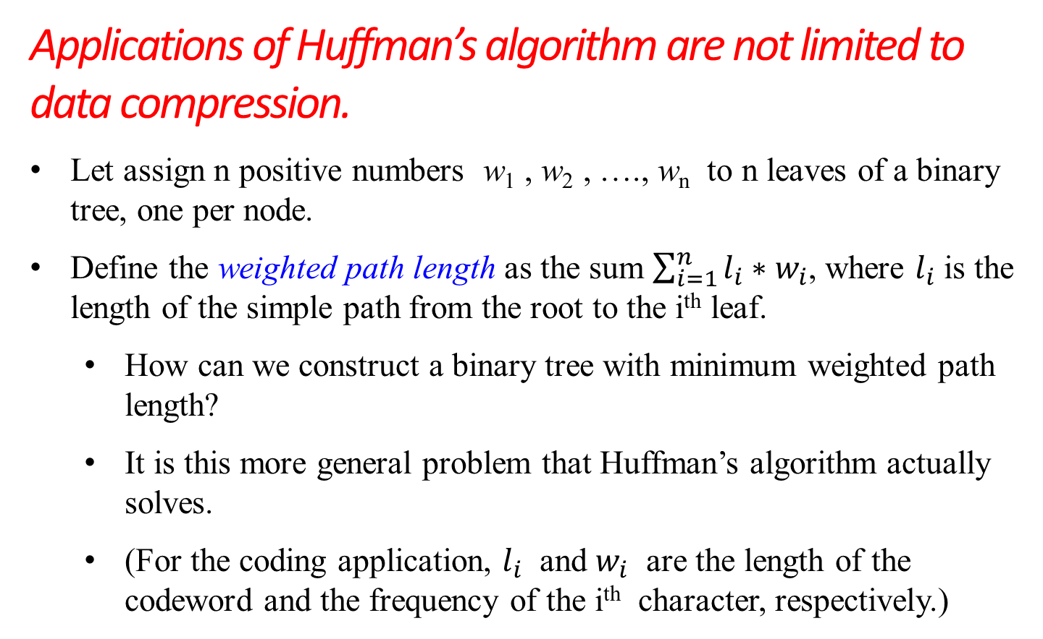
Applications of Huffman’s algorithm are not limited to data compression.
Let assign n positive numbers w₁ , w₂ , …., w_{n} to n leaves of a binary tree, one per node.
Define the weighted path length as the sum $\sum_{i=1}^{n}{l_{i}∗w_{i}}$, where $l_{i}$ is the length of the simple path from the root to the i^{th} leaf.
How can we construct a binary tree with minimum weighted path length?
It is this more general problem that Huffman’s algorithm actually solves.
(For the coding application, $l_{i}$ and $w_{i}$ are the length of the codeword and the frequency of the i^{th} character, respectively.)

Slide 45
Need Huffman’s algorithm to solve this problem in its general case.
This problem arises in many situations involving decision making.
For example, consider the game of guessing a chosen object from n possibilities (say, an integer between 1 and n) by asking question answerable by yes or no.
Different strategies for playing this game can be modeled by decision trees such as those depicted in Figure 9.13 for n = 4.

Slide 46
n>4
n>2
no
yes
no
yes
n>3
n = 4
n>1
n>3
no
yes
no
yes
no
yes
n>2
n = 3
n = 1
n = 2
n = 3
n = 4
no
yes
n = 1
n = 2
Figure 9.13 Two decision trees for guessing an integer between 1 and 4.

Slide 47
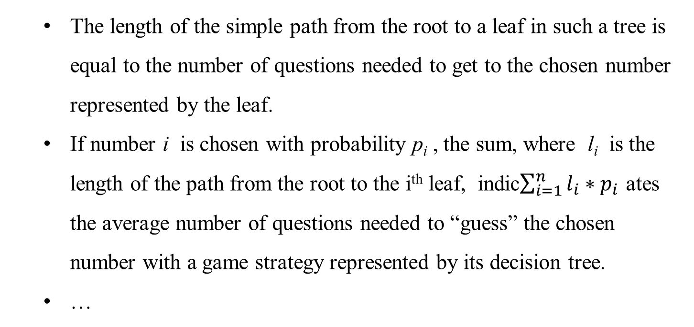
The length of the simple path from the root to a leaf in such a tree is equal to the number of questions needed to get to the chosen number represented by the leaf.
If number i is chosen with probability p_{i} , the sum, where l_{i} is the length of the path from the root to the i^{th} leaf, indic$\sum_{i=1}^{n}{l_{i}{∗p}_{i}}$ ates the average number of questions needed to “guess” the chosen number with a game strategy represented by its decision tree.
…

Slide 48
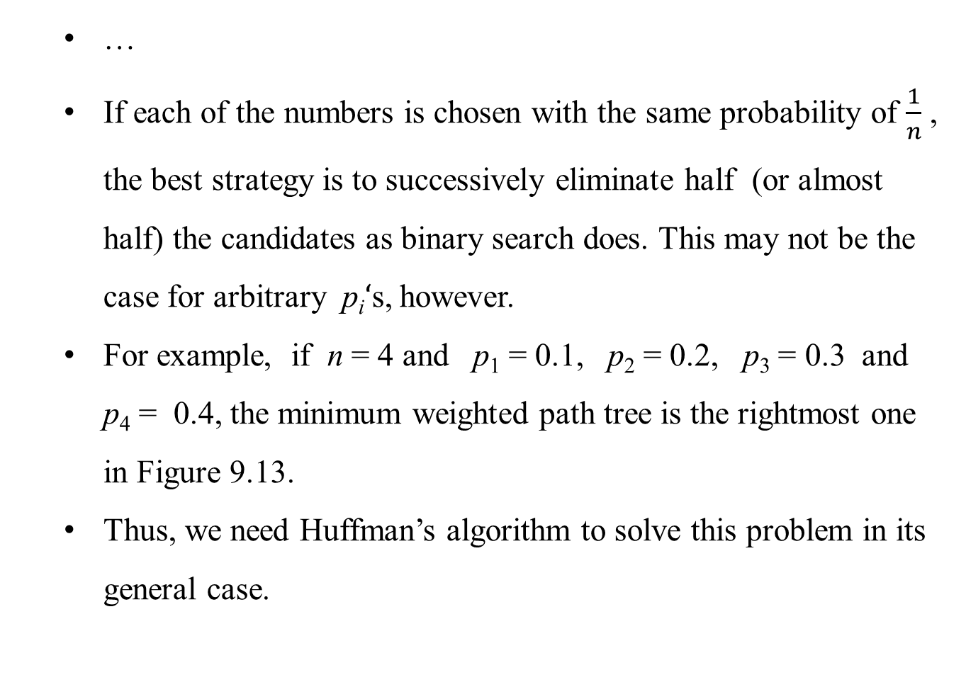
…
If each of the numbers is chosen with the same probability of $\frac{1}{n}$ , the best strategy is to successively eliminate half (or almost half) the candidates as binary search does. This may not be the case for arbitrary p_{i}$‘$s, however.
For example, if n = 4 and p₁ = 0.1, p₂ = 0.2, p₃ = 0.3 and p₄ = 0.4, the minimum weighted path tree is the rightmost one in Figure 9.13.
Thus, we need Huffman’s algorithm to solve this problem in its general case.

Slide 49
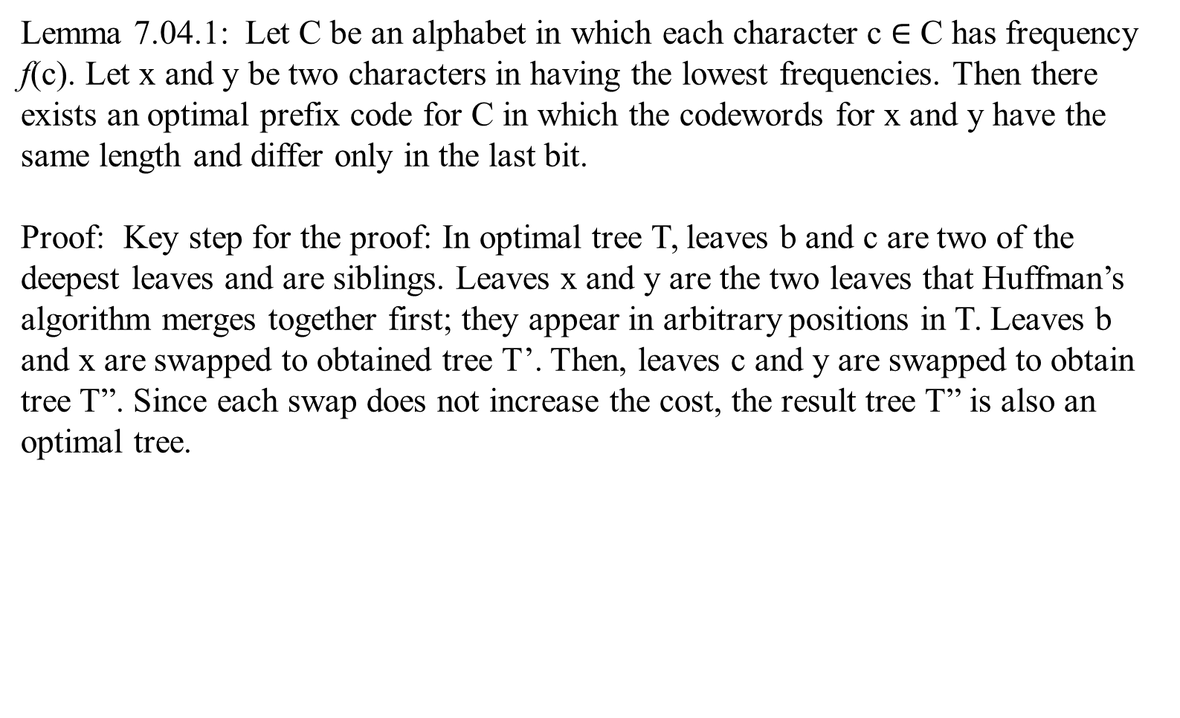
Lemma 7.04.1: Let C be an alphabet in which each character c $∈$ C has frequency f(c). Let x and y be two characters in having the lowest frequencies. Then there exists an optimal prefix code for C in which the codewords for x and y have the same length and differ only in the last bit.
Proof: Key step for the proof: In optimal tree T, leaves b and c are two of the deepest leaves and are siblings. Leaves x and y are the two leaves that Huffman’s algorithm merges together first; they appear in arbitrary positions in T. Leaves b and x are swapped to obtained tree T’. Then, leaves c and y are swapped to obtain tree T”. Since each swap does not increase the cost, the result tree T” is also an optimal tree.
T
T’
T”
…….
…….
…….
…….
x
…….
x
…….
x
x
…….
x
…….
x
…….
x
x
x
x
x
x

Slide 50
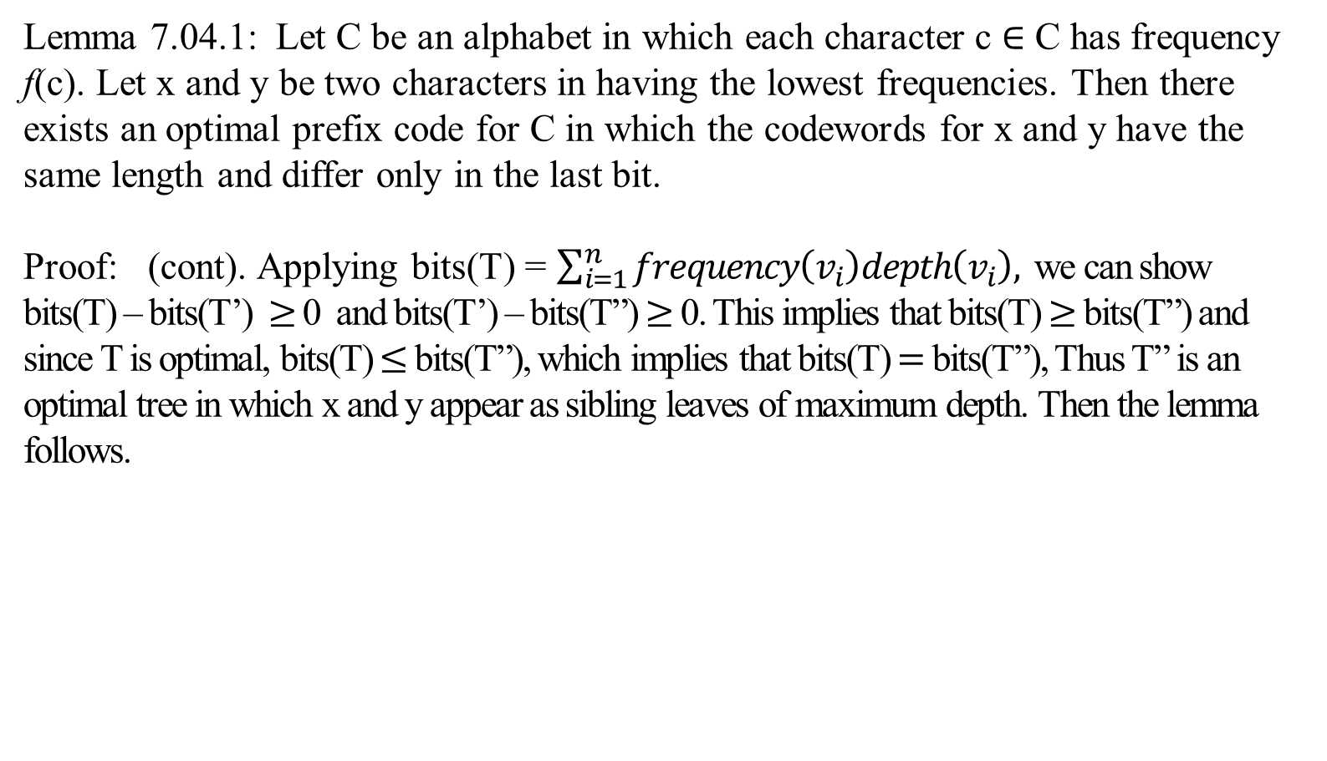
Lemma 7.04.1: Let C be an alphabet in which each character c $∈$ C has frequency f(c). Let x and y be two characters in having the lowest frequencies. Then there exists an optimal prefix code for C in which the codewords for x and y have the same length and differ only in the last bit.
Proof: (cont). Applying bits(T) = $\sum_{i=1}^{n}{frequency\left(v_{i}\right)depth\left(v_{i}\right),}$ we can show bits(T) – bits(T’) $≥$ 0 and bits(T’) – bits(T”) $≥$ 0. This implies that bits(T) $≥$ bits(T”) and since T is optimal, bits(T) $≤$ bits(T”), which implies that bits(T) $=$ bits(T”), Thus T” is an optimal tree in which x and y appear as sibling leaves of maximum depth. Then the lemma follows.
T
T’
T”
…….
…….
…….
…….
x
…….
x
…….
x
x
…….
x
…….
x
…….
x
x
x
x
x
x

Slide 51
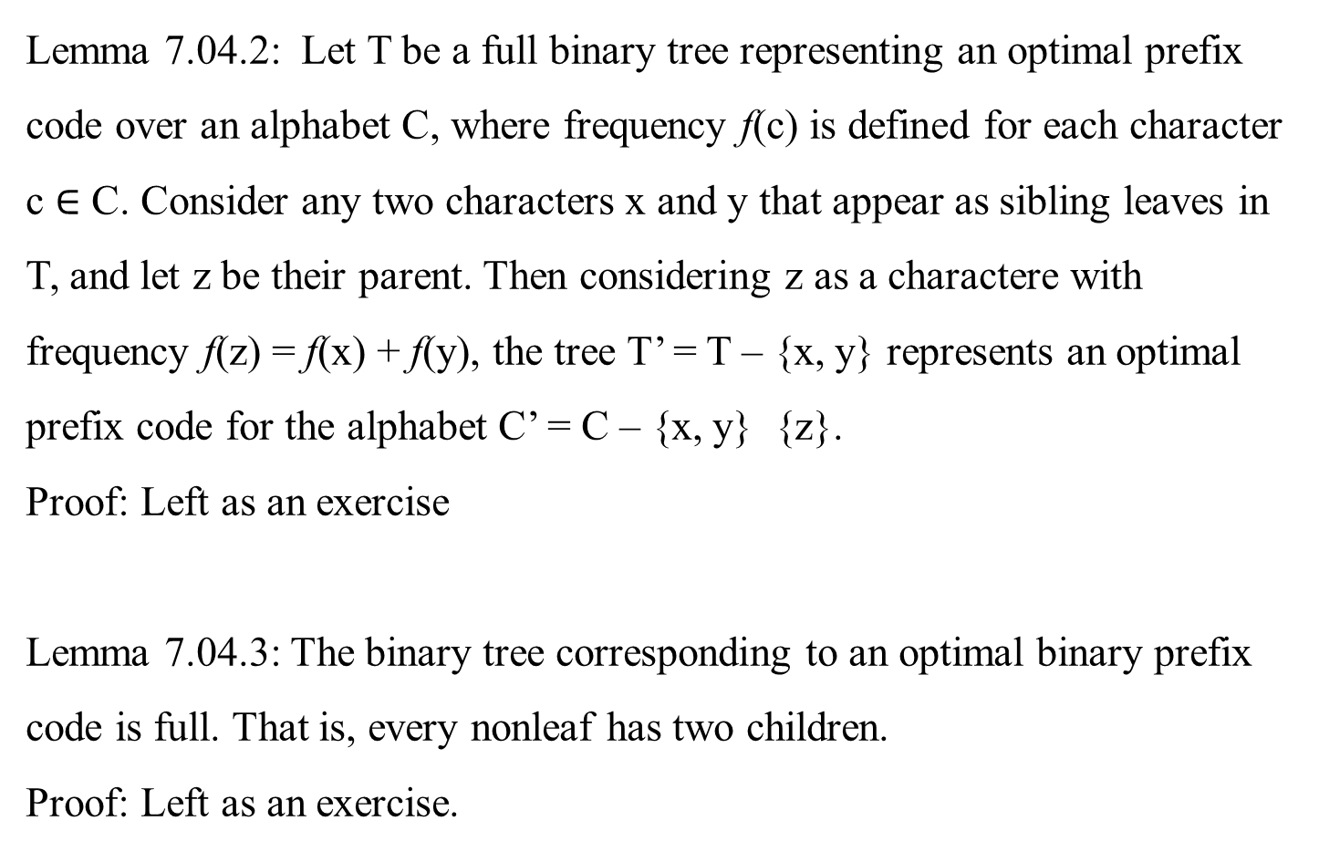
Lemma 7.04.2: Let T be a full binary tree representing an optimal prefix code over an alphabet C, where frequency f(c) is defined for each character c $∈$ C. Consider any two characters x and y that appear as sibling leaves in T, and let z be their parent. Then considering z as a charactere with frequency f(z) = f(x) + f(y), the tree T’ = T – {x, y} represents an optimal prefix code for the alphabet C’ = C – {x, y} {z}.
Proof: Left as an exercise
Lemma 7.04.3: The binary tree corresponding to an optimal binary prefix code is full. That is, every nonleaf has two children.
Proof: Left as an exercise.

Slide 52
Theorem: 7.04.3: Huffman’s algorithm produces an optimal binary code.
Proof: Immediate from Lemmas 7.04.1, 7.04.2, 7.04.3.

Slide 53
The End

Slide 54
In Ch 07_05Q Extension of Kruskal’s Algorithm, it has 19 viewgraphs regarding an extension of
Kruskal’s Algorithm on disjoint set data structure, which deals with improving of the “Worst-Case Time-Complexity of Kruskal’s Algorithm”.

